Slide 1
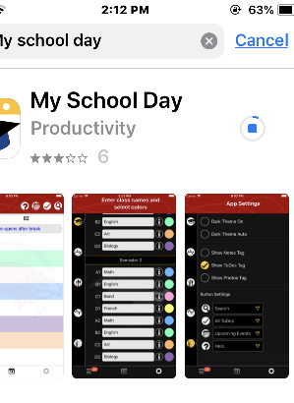
If you haven’t downloaded it yet…
Wifi: SD43-S
Use your user name and password (on timetable)
Go to App Store or Google Play
Search: My School Day

Slide 2

Welcome to
Port Moody Secondary School

Slide 3
Follow us on Instagram:
portmoodyblues43
pmss_stuco
pmss.athletics
pmsslearningcommons
pmsstheater
pmss_bluesleadership
Chess_waffle_news

Slide 4

Port Moody Secondary School is situated on the core traditional territory of the
kʷikʷəƛ̓əm (Kwikwetlum) First Nation
which lies within the shared territories
of the
Səlil̓w̓ətaɬ (Tsleil-Waututh),
sq̓əc̓iy̓aɁɬtəməxʷ (Katzie),
xʷməθkwəy̓əm (Musqueam),
qiqéyt (Qayqayt), and
Sḵwx̱wú7mesh Úxwumixw (Squamish) Nations.
Phoenix Rising
Morgan Asoyuf
Ts'msyen Eagle Clan
This Photo by Unknown Author is licensed under CC BY-SA
Notes:
Kwikwetlum : Kway-quet-lam
səl̓ilwətaɁɬ təməxʷ Tsleil-Waututh): Slay-wa-tooth
Skwxwú7mesh-ulh (Squamish)
Stó:lō
Qayqayt (Kee-Kite)
Stz’uminus (Chemanus)
Musqueam

Slide 5
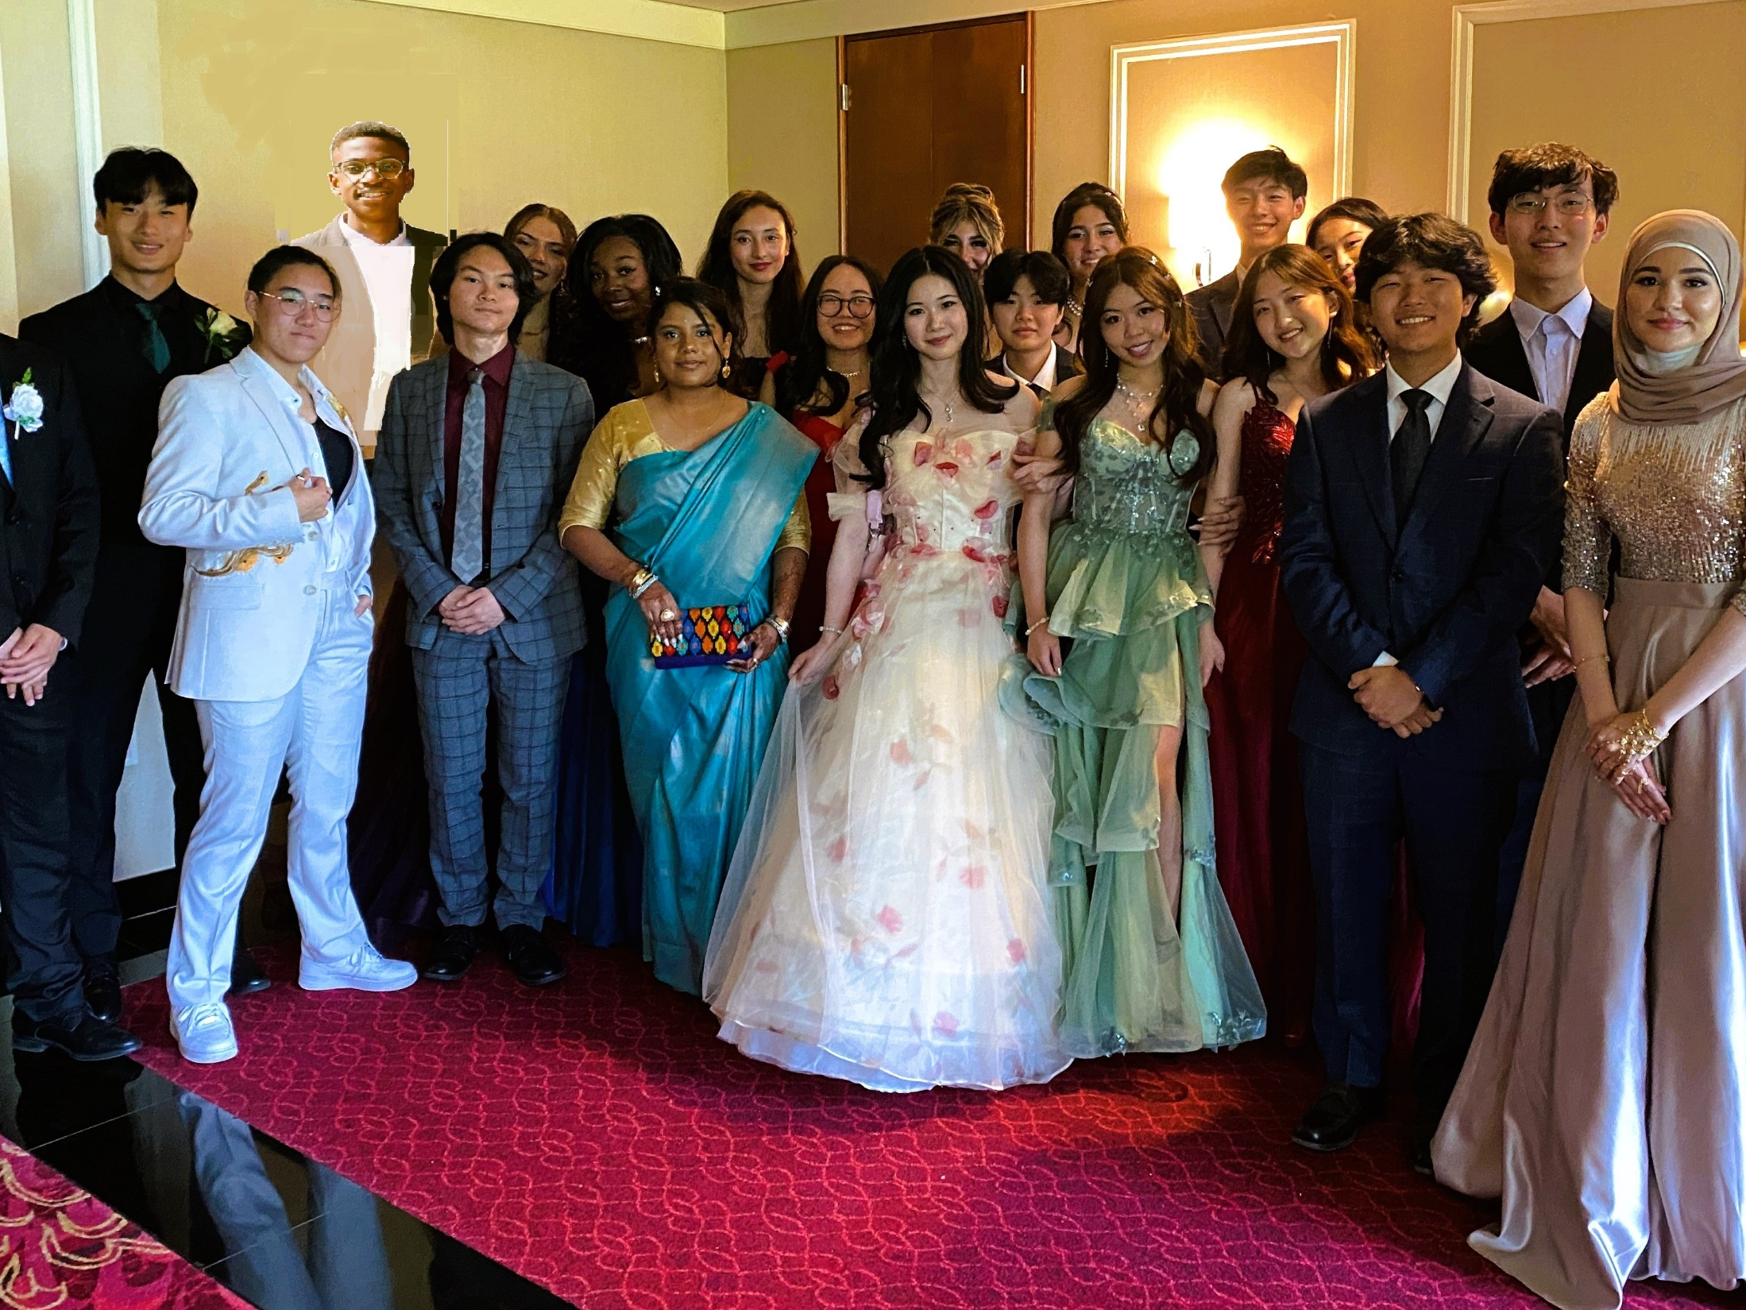
Welcome Grad Class 2029

Slide 6
We’re here to help!
SOAR leaders
  Grade 11 & 12 students
  Go into your Science and English classes
  Answer questions, take you on tours, give you some tips on adjusting to high school

Slide 7
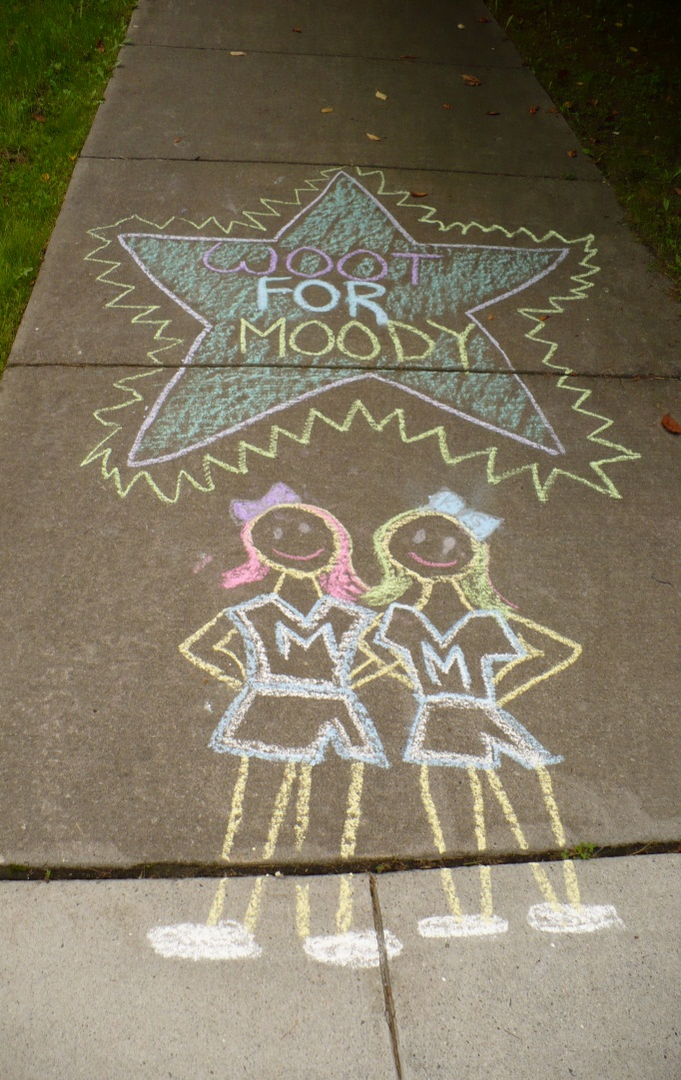
We’re here to help you have a great year!
Counsellors
  Ms. Campbell (A-Jo)
  Dr. Maeirle(Jp-Neb)
  Ms. Sidhu (Nec-Z)
  Mr. Millin – International Education
PMSS Administration
  Mr. Lloyd
  Ms. Livingstone(A-Jh)
  Mr. Cameron (Ji-Pn)
  Ms. Martin (Po-Z)

Slide 8
We’re here to help you have a great year!
IB Coordinators
  Mr. Lenihan, Ms. Sarte & Ms. Tsui
Youth Worker
  Ms. Penner Hunt
International Education Coordinator
  Mr. Millin
PMSS Teachers
PMSS Support Staff

Slide 9
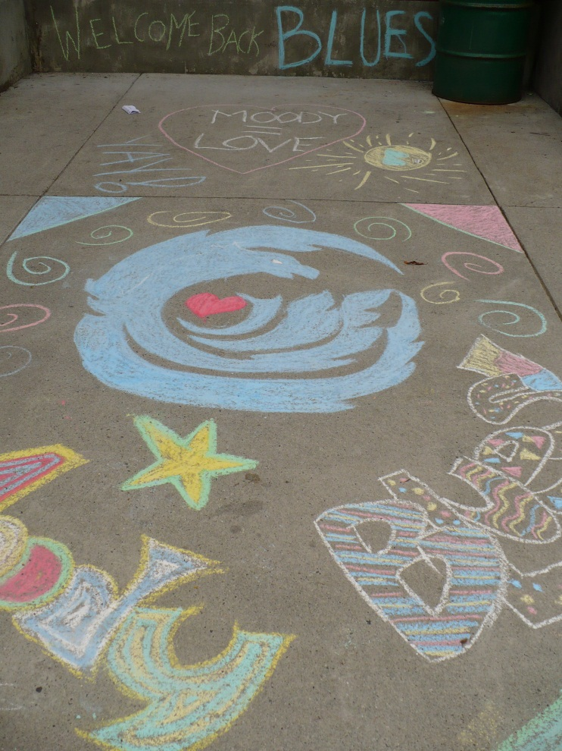
Homeroom Class
During the first week of school, will meet Wed, Thurs and Fri.
10:10-11:10
Hand in forms, Fees, newsletters etc.
Introduction to Digital Literacy 10
Rest of the year: “Walk-through Homeroom” throughout the year to collect report cards, etc.

Slide 10
Schedules
At PMSS, we have 2 different bell schedules.
Monday Bell Schedule
  8:50-2:02 67 min classes
Flex Bell Schedule (Tues-Fri)
  8:56-3:16 75 min classes

Slide 11
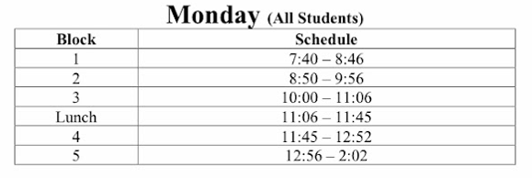
Monday Bell Schedule
Most Grade 9 students will NOT have a block 1 class

Slide 12
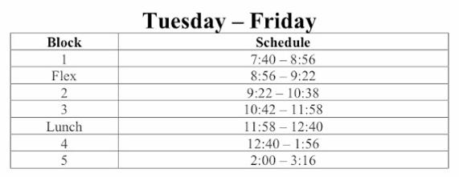
Flex Bell Schedule (Tuesday-Friday)
Most Grade 9 students will NOT have a block 1 class

Slide 13
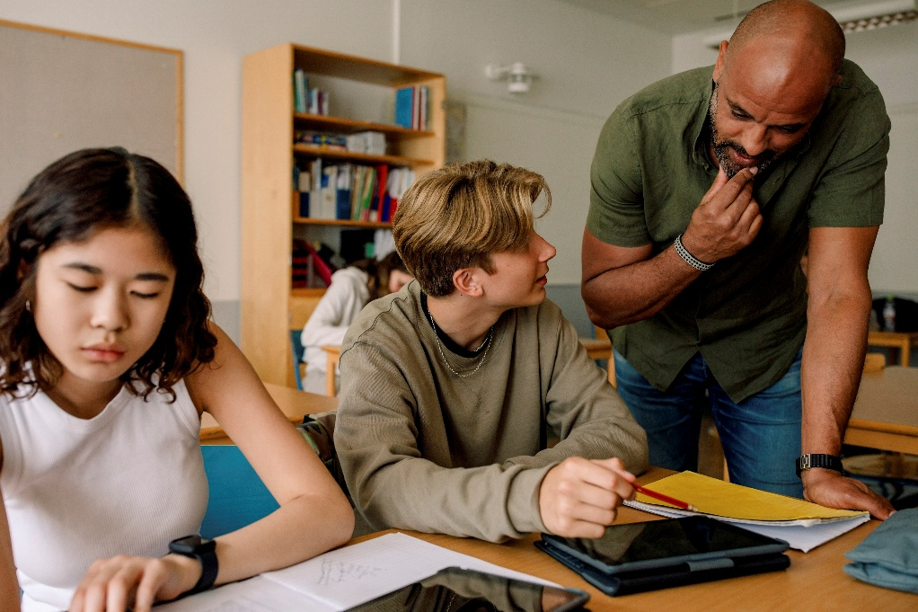
What is Flex?
Opportunity to meet with a teacher one on one or in a small group
Catch up on missed work due to absences
Ask questions about challenging content
Get feedback on assignments before handing them in
Get help with challenging homework
Meet with group members to work on group projects
Write quizzes that were missed due to absences
Tuesday-Friday
8:56-9:22

Slide 14
For Next week…
Tuesday, Sept 2nd
  Homeroom
  Go directly to your homeroom class
Grade 9’s 10:15-11:30
Grade 10-12 11:00-11:30

Slide 15
Wednesday Sept 3rd-Friday Sept 5th
Wednesday-Friday: 8:56 - 3:16
  Homeroom Schedule
  Go directly to block 2 class at 8:56
Monday: 8:50 - 2:02
  Regular Monday Bell Schedule

Slide 16
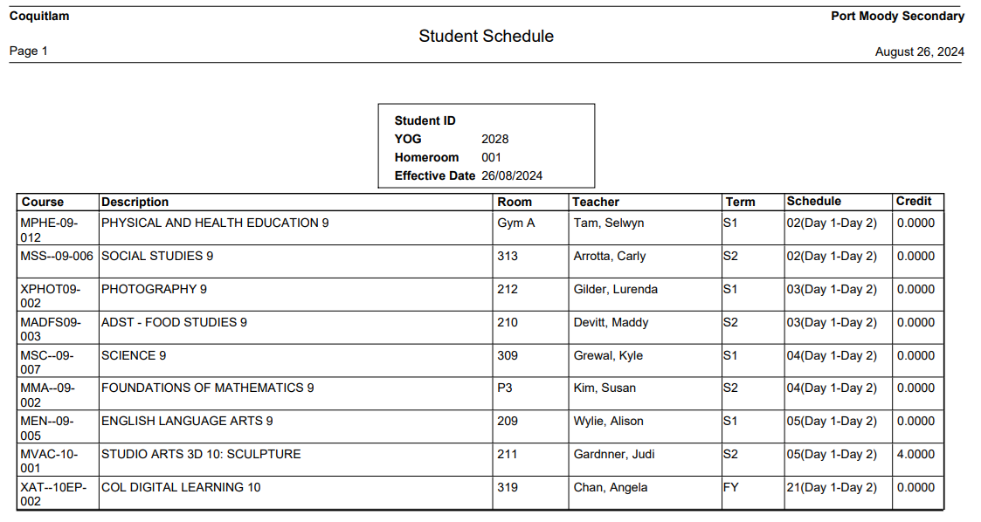
How to read your timetable
Homeroom

Slide 17
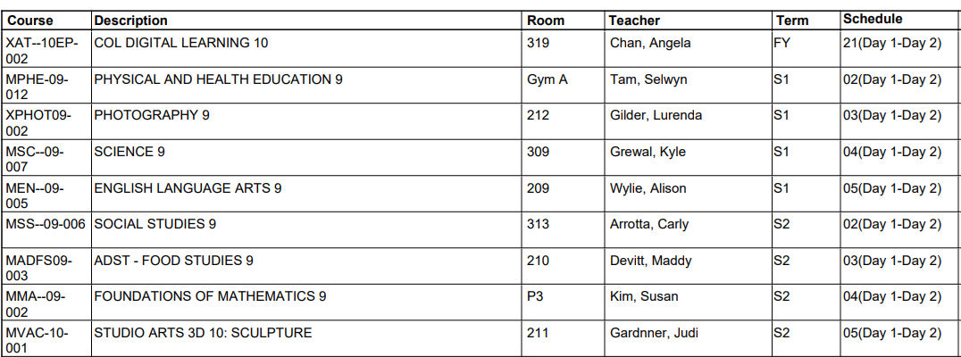
Year Long Classes
Semester the course is taught in.
FY: Digital Literacy 10 runs all year, so it is assigned as a FY (full year) course.
COL Digital Learning 10: On-line course.
There will be assemblies & meetings to explain the assignments.
Notes:
Music and Band courses are also FY. Concert band 9/10 is block 0 (7:10 start) Choir and Jazz band are at lunch (block 3) Strong Orchestra is after school.

Slide 18
Year Long Classes
Block the course is in.
Block 21: Digital Literacy 10 is mostly an on-line course. You will have meetings with your teacher throughout the year, but it is not assigned a block in your day.
Room the course is taught in.
Notes:
Music and Band courses are also FY. Jazz Band 9 is in block 1 (7:40 -8:56) Concert band 9 and choir 9 are in block 5, often backed with PE. So, they have PE day 1 and concert band/choir day 2 (or vice versa).

Slide 19
Semester 1 Classes
Most students will not have a block 1 class. Block 1 is 7:40-8:50.
So your first class will be
block 2.
Block

Slide 20
Most grade 9’s have 9 classes in total.
Digital Learning 10, English, Social Studies, Science, Math, PE + 3 electives.
2nd Semester classes
(February-June)
Notes:
If they are missing a course, they should fill out the Course Correction Form that will be on the school website.

Slide 21
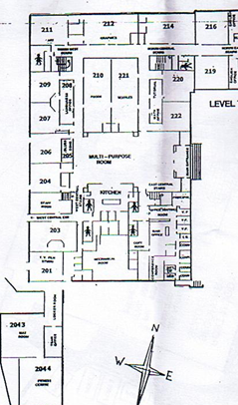
General Layout of the School
200 level
All Room numbers start with 2
  E.g. 201, 210, 220…
Main entrance to the school
Cafeteria (MPX)
Office
LRC & Access to Portables
Math Office & Classrooms
Foods & Textiles
Languages
Art
English

Slide 22
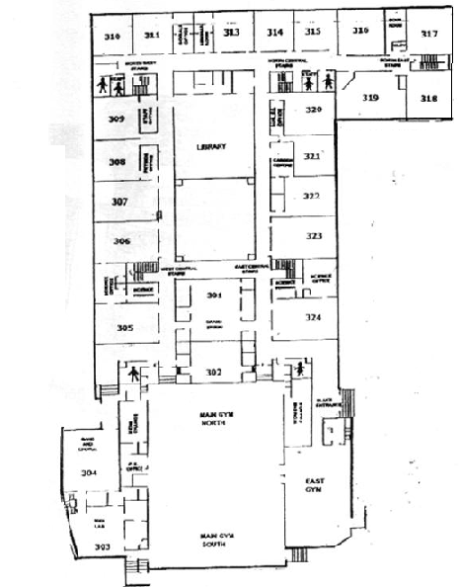
General Layout of the School
300 level
All rooms begin with 3, e.g. 301, 309, 323…
Upstairs from main entrance to the school
Main Gym & Small Gym
Music Wing & Access to Portables
Drama Room
Science Wing
Library
Socials and English Wings
Computer Labs

Slide 23
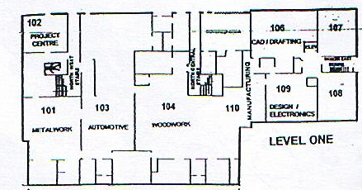
General Layout of the School
100 level
  Only in the North side of the school
  Primarily tech ed
    Auto Mechanics
    Woodwork
    Metalwork & Jewelry
    Electronics
    Engineering
    Drafting
  2 Math Rooms (107, 108)
  Access to Portables

Slide 24
If you haven’t downloaded it yet…
Wifi: SD43-S
Use your user name and password (on timetable)
Go to App Store or Google Play
Search: My School Day

Slide 25










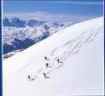
What are some tips to having a good year at PMSS?
Join, Join, Join!
  40 clubs
  20 teams
  Student council
  Intramurals
Ask lots of questions!!

Slide 26
Get involved with school events
PMSS Blues Leadership class organizes many school wide events.
Instagram: pmss_bluesleadership
Every Friday: Blues Friday
Welcome Back Week September 8-15th:
Spirit Week
  ^{Monday: Grade Colours}
  Tuesday: School Year Resolution
  Wednesday: Vacation Vibes (dress summer holiday) & Freezie Sale at lunch
  Thursday: Roll out from your Bed day (PJ Day)
  Friday: Blues Wear & Popcorn sale at lunch. Music in the MPR.

